Slide 1


Presents:
Kissan-Tech

Slide 2
Ideology
We believe that nothing is more satisfying than easing the work of our farmers.
The farmers spend hours and hours taking care of their farms.
We tend to help them by our idea which will not only save their time but will also decrease their work.
We have created an automatic plant watering system which will help farmers in irrigation by saving their time, and effort.
The project will also save electricity and water.

Slide 3
Technology Used
Arduino UNO Microcontroller
Soil Moisture Sensor
Relay Module
Water Pump
DHT Sensor
HTML
CSS
Bootstrap
JS
Express JS

Slide 4
Abstract
We have chosen this project as India is an agriculture oriented country and the rate at which water resources are depleting is a dangerous threat hence there is a need of smart and efficient way of irrigation, which detect the humidity in the soil (agricultural field) and supply water to the field which has water requirement. The project is ARDUINO UNO micro-controller based design which controls the water supply in the field to be irrigated.
There sensors present in each field, are not activated till water is present on the field. Once the field gets dry sensors sense the requirements of the water in the field and send a signal to the micro-controller. The Micro-controller then supply water to that particular field which has water requirement till the sensors is deactivated again. In case, when there are more than one signal for water requirement then the micro-controller will prioritize the first received signal and irrigate the fields accordingly

Slide 5
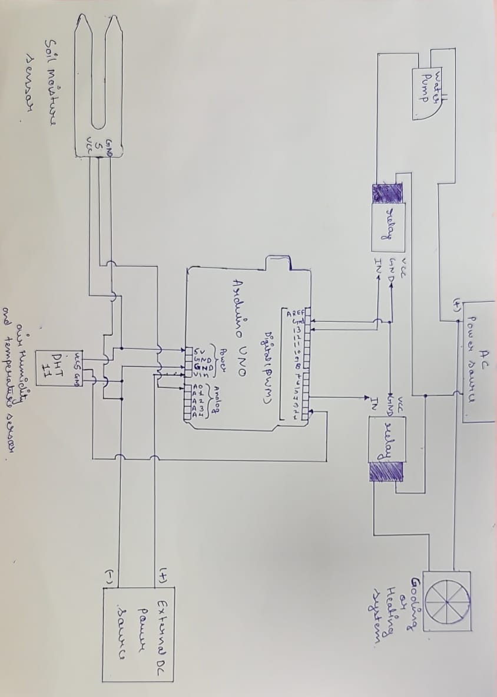
Circuit Diagram

Slide 6
Working
First we program the micro-controller and set the values of soil moisture and air humidity and temperature. Now the soil moisture sensor and DHT sensor sends the real time values of humidity and temperature of soil and it’s surrounding. If the values of humidity and temperature send by both the sensor is greater than the preset threshold value , then the micro-controller will send a signal to relays to turn on the pump or cooling/heating system. If the sensor values of moisture or humidity is low than the threshold value, it will turn off the pump or cooling/heating system.

Slide 7
Conclusion
Thus the Automatic Plant Watering System has been designed and tested successfully. It has been developed by integrated features of all the hardware components used. Presence of every module has been reasoned out and placed carefully, thus contributing the best working of the unit. The system has been tested to function automatically.

Slide 8
Team Members
Anish
Ankit Dagar
Lakshit Sharma
Sanchit Bajaj
Vaibhav Chopra

